Slide 1
When to initiate feeds and how much to feed LBW infants?
Notes:
Dear friends, in this webinar we shall learn when to initiate feeds and how much to feed in LBW infants

Slide 2
When to initiate feeds?
All LBW infants
Start full enteral feeds at admission or birth
    Except in some infants
Notes:
All LBW infants should be started on full enteral feeds immediately after birth; for outborn neonates, full feeds should be started at admission. The enteral feeds may be in the form of direct breastfeeding, expressed breast milk, or formula (in rare cases)
There are only a few exceptions in whom full oral feeds are not to be started at birth or admission.

Slide 3
In which infant/ clinical condition can feeds not be started?
Exceptions
Weight <1000 gm or gestation <29 weeks
Shock requiring inotropes
Respiratory failure requiring
mechanical ventilation
4. Severe asphyxia
(no cry by 5 mins; chest compressions)
5. Active seizures
6. Obvious abdominal distension/blood/bilious vomit or aspirate
7. Surgical conditions of GI tract
If any of these present:
Keep NPO; reassess after 12-24 hrs
Notes:
These exceptions include weight <1000 g or gestation <29 weeks; shock requiring inotropes; respiratory failure requiring mechanical ventilation;
severe asphyxia defined as no cry by 5 min or need for chest compressions; active and ongoing seizures; obvious abdominal distension with or without blood/bilious aspirate or vomiting; and finally, surgical conditions of GI tract like intestinal atresia
If any of these conditions are present, keep the baby nil per oral, and reassess after 12-24 hours.

Slide 4
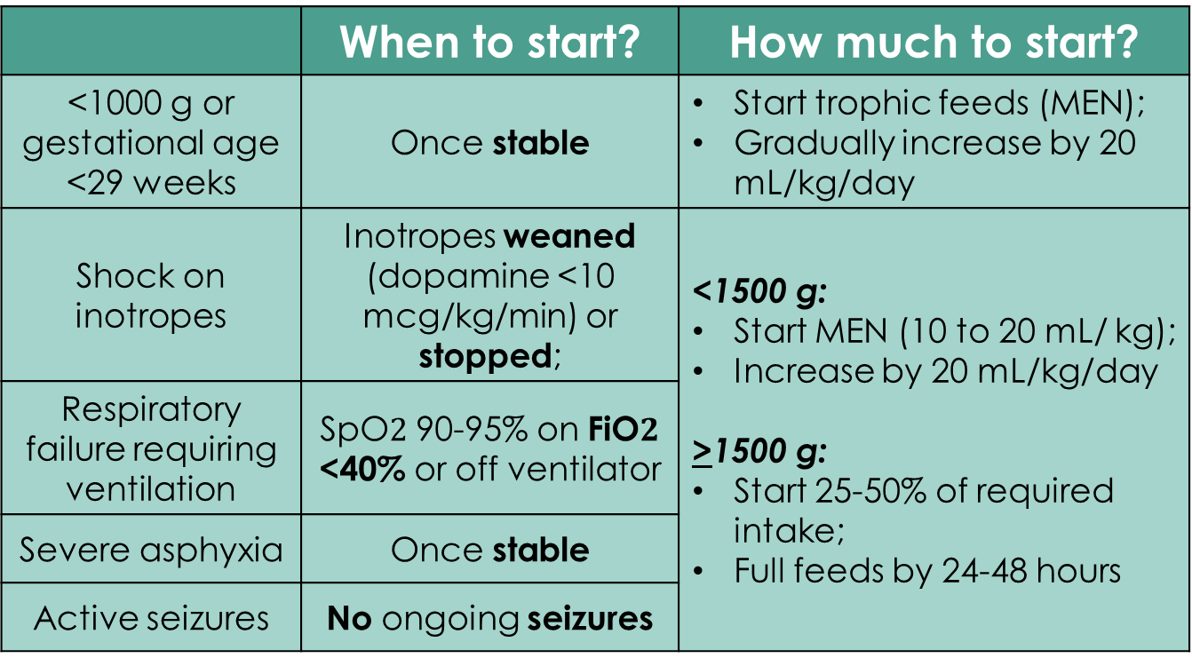
When to initiate feeds?
Exceptions
 | When to start? | How much to start?
<1000 g or gestational age <29 weeks | Oncestable | Start trophic feeds (MEN); Gradually increase by 20 mL/kg/day
Shock on inotropes | Inotropes weaned (dopamine <10 mcg/kg/min) or stopped; | <1500 g: Start MEN (10 to 20 mL/ kg); Increase by 20 mL/kg/day >1500 g: Start 25-50% of required intake; Full feeds by 24-48 hours
Respiratory failure requiring ventilation | SpO$2$ 90-95% on FiO$2$<40% or off ventilator
Severe asphyxia | Once stable
Active seizures | No ongoing seizures
Notes:
Upon reassessment, we can start these babies on feeds if they are stable, i.e. maintaining normal temp, HR, RR, saturations and capillary refill time with or without support.
For babies <1000 g, we start MEN - minimal enteral nutrition or trophic feeds; This means giving feeds at 10 to 20 ml/kg/day for a few days and then gradually increasing by 20 ml/kg/d
In other conditions such as respiratory failure, shock, asphyxia, or seizures, we can be little more aggressive in starting feeds – can start at 25 to 50% of required intake for that day; if the baby is accepting feeds well, give full feeds in the next 24-48 hours. But if the baby is <1500 g, start MEN and then gradually increase feeds by 20 ml/kg/d

Slide 5
When to initiate feeds?
Exceptions
 | When to start? | How much to start?
Abdominal distension or blood/bilious vomit | No distension or vomit in last 24 hrs. | Start 10-20 mL/kg; Gradually increase by 20-30 mL/kg/day
Surgical conditions of GI tract | Until surgical condition resolves
If feeds increased gradually, stop IV fluids upon reaching 100 mL/kg/day
Notes:
In babies with abdominal distension or surgical conditions of gastrointestinal tract, we can start feeds if there is no abdominal distension or vomiting in the last 24 hours and the abdomen is soft.
In these babies, we usually start feeds at 10-20 ml/kg/d and increase gradually by 20 to 30 ml/kg/d
In all the babies in whom feeds are started slowly, we have to assess if the baby is tolerating feeds by careful inspection of abdomen before each feed. We shall learn about monitoring of feed intolerance in a separate webinar later.
If feeds are increased gradually, the baby has to be kept on IV fluids till the baby reaches 100 ml/kg/d of feeds after which we can stop IV fluids.

Slide 6
How much to feed?
Day of life | Fluid requirements (mL/kg/day)
 | > 1500 gm | < 1500 gm
Day 1 | 60 | 80
Day 2 | 80 | 95
Day 3 | 100 | 110
Day 4 | 120 | 120
Day 5 | 140 | 130
Day 6 | 150 | 140
Day 7 onwards | 160 | 150
Feed every 2-3 hours
Notes:
The daily requirement of fluids in LBW babies is provided in this table.
For babies with BW of 1500 g or more, we start at 60 ml/kg on day 1 of life. We increase the amount by 20 ml/kg every day till the baby reaches 160 ml/kg by day 7.
In VLBW babies, we usually start at 80 ml/kg on day 1 of life. The amount is increased by 15 ml/kg every day till the baby reaches 150 ml/kg by day 7.
Feeds should be given every 2-3 hours in all LBW babies.

