Slide 1
Sepsis screen
Dr. Ramesh Agarwal
MD, DM (Neonatology)
Professor
Department of Pediatrics
All India Institute of Medical Sciences, New Delhi

Slide 2
Sepsis screen
Absolute neutrophil count (ANC; <1800/mm³)
Immature to total neutrophil (I/T) ratio (>20%)
Micro-ESR (>15 mm 1st hour)
CRP +ve (>10 mg/L)
*If two or more criteria are present, we label sepsis screen as positive
Notes:
Sepsis screen has four components. No 1 Absolute neutrophil count <1800 per cubic mililitre, No 2 immmature to total ratio more than 20%, no 2, micrp ESR more than 15 mm fall in first hour and no 4 serum CRP level more than 10 mg/Litre.
When two or more components are present, the sepsis screen is said to be positive.

Slide 3
Absolute neutrophil count (ANC)
Do TLC and DLC
Notes:
For doing absolute neutrophil count or ANC, we do total and differential leucocyte count.

Slide 4
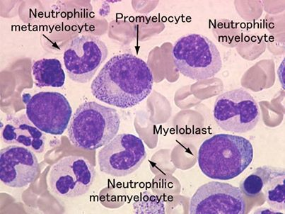
Neutrophils
Promyelocyte Metamyelocyte Band
Mature neutrophils
Immature Neutrophils
Count all neutrophils- mature and immature
Notes:
When ever there is sepsis and inflammation, there is shift to left in the blood cells seen in peripheral smear. ‘shift to left’ means that apart from mature neutrophils, immature neutrophils from bone marrow move to peripheral blood. The slide shows picture of immature neutrophils that generally appear in circulation. A mature neutrophils have a nucleus which is multilobed and segmented. While different immature cells have a single nucleus that is still unsegmented as the process of lobulation has not been completed as yet.
We count both immature as well as mature neutrophils while doing differential count.

Slide 5
Absolute neutrophil count
ANC is calculated by
  TLC X % neutrophils (immature + mature)
  100
TLC- 10,000/cm; mature neutrophils - 40; Immature -10; lymphocyte – 48; eosinophil-2
  ANC= 10000(40+10)/100 = 5000
Notes:
From TLC and DLC we calculate ANC and IT ratio.
For ANC, we take all neutrophils mature as well as immature and multiply it with TLC and divide by 100. for e.g. if TLC is 10000. In differential, we find mature neutrophils - 40, band- 5, promyelocyte – 3, metamyelocyte-2, lymphocyte- 48, eosinophil-2. the ANC would be 10000* total neutrophils i.e. (40+5+3+2)/100 which equals to 5000. so ANC is this example is 5000.

Slide 6
Immature to total neutrophil ratio (IT ratio)
Mature neutrophils - 40, band - 5, prometamyelocyte - 3, metapromyelocyte -2, lymphocyte - 48, eosinophil -2
IT ratio: (10/ 50) X 100 = 20%
Notes:
To calculate immature to total neutrophil ratio in previous example. We calculate immature neutrophils which is band- 5, prometamyelocyte – 3, metapromyelocyte-2, that add up to 10 and total neutrophil is 50 so the ratio comes out to be 20%.

Slide 7
Sepsis screen
Serum CRP: quantitative or semi-quantitative: >10 mg/ dL
A separate video on how to do CRP
Notes:
Serum CRP can be performed as a quantitative test in which we get precise levl of CRP in the serum or it could qualitative which gives us different cut offs. We will see a separate video on how to do CRP test.

Slide 8
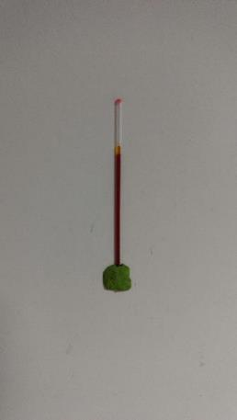
Micro ESR
Take 75 mm microcapillary
Heparinize, close one end and suspend vertically on the wall
Measure fall of RBC column in first hour
Notes:
Micro-ESR is done by taking a 75 mm capillary, heparinizing it, filling it with blood and suspending it on the wall for one hour. We take measurement after one hour and see amount of fall in blood. We will see a different video on it.

Slide 9
Key message
Sepsis screen is a panel of 4 tests namely ANC, IT ratio, micro ESR and serum CRP levels
If two or more criteria are positive, screen is said to be positive
Notes:
Sepsis screen is panel of 4 tests namely ANC, IT ratio, Micro ESR and S. CRP levels.
if two or more criteria are positive, screen is said to be positive.

