Slide 1
ROP Treatment
Dr. PARIJAT CHANDRA
MD, DNB
Additional Professor (Ophthalmology)
Vitreoretina & ROP Services,
R.P. Centre, AIIMS, New Delhi

Slide 2
Indications of laser treatment
Early Treatment of ROP (ETROP) guidelines
Type I ROP - Treat
  Zone I, any stage with plus
  Zone I, stage 3 without plus
  Zone II, stage 2-3 with plus
  (Including APROP)

Slide 3
Mechanism of laser
Laser destroys avascular retina
Removes ischemic stimulus
Decrease neovascularization, fibrovascular proliferation
Regression of ROP

Slide 4
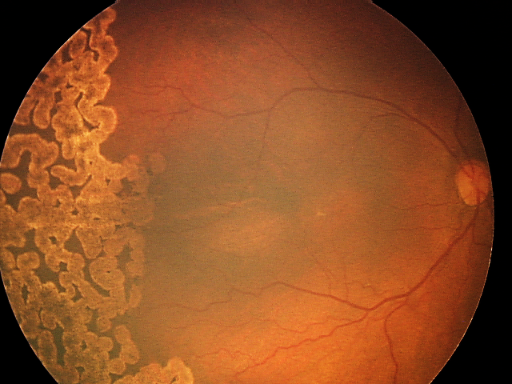
Laser procedure
Informed parental consent necessary
Monitoring by neonatologist
Laser photocoagulation of avascular retina within 48 hours when indicated
Both eyes – 1 sitting under topical anesthesia by trained expert using indirect laser ophthalmoscope
Lasered regressed ROP

Slide 5
Post laser follow up
Antibiotic/ steroid + tears eye drops TDS – 5 days
Follow up 1 weekly to observe ROP progression/ regression
Review for laser augmentation in skip areas
Long term follow up 4 monthly for retinal status and refraction

Slide 6
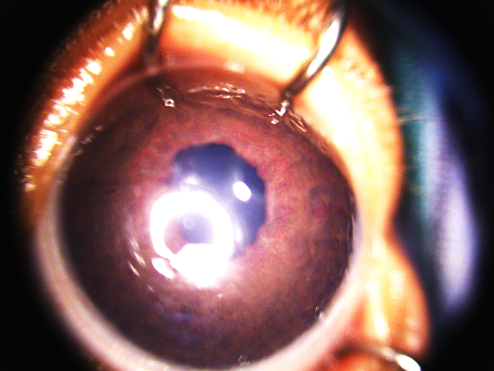
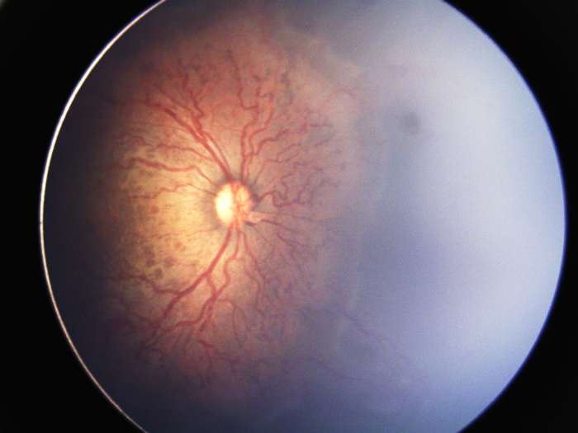
Current usage: Anti VEGF drugs
Significant benefit in Zone 1 ROP (APROP) regression - adjunct to laser treatment
Helps reduce iris neovessels - pupillary dilation in rigid pupils with plus disease, allowing laser treatment
Promote vascularization towards into periphery - improving visual field (unlike laser)
Iris neovessels with rigid pupil
APROP with severe plus disease

Slide 7
Limitations of anti VEGF drugs
No clarity on dose/ number of injections
No clarity on which anti VEGF drug is better
Risk of systemic absorption and side effects
No study on long term outcomes
Delayed recurrences common

Slide 8
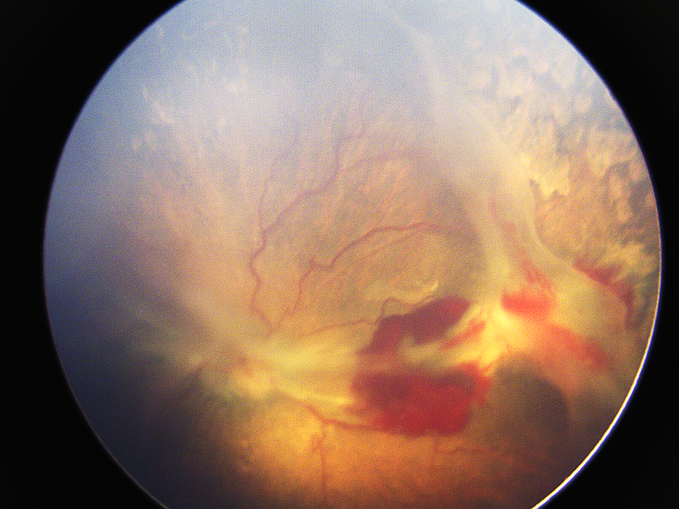
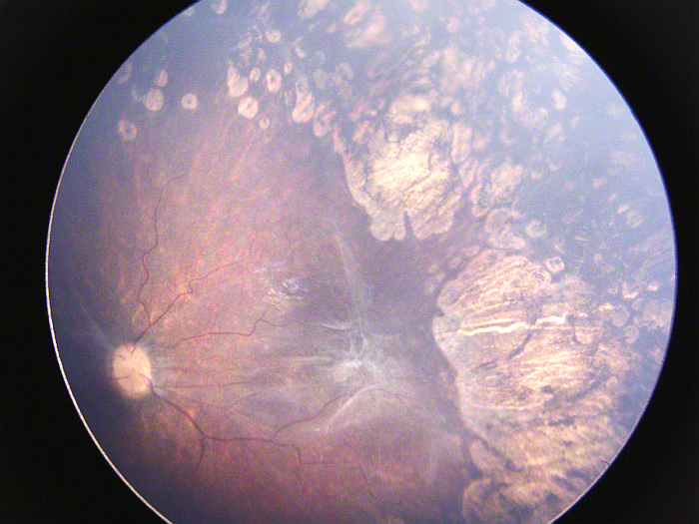
ROP surgery
Stage 4 ROP - Subtotal retinal detachment
25G/27G lens sparing vitreoretinal surgery - good outcomes
Stage 4B ROP
Postoperative

Slide 9
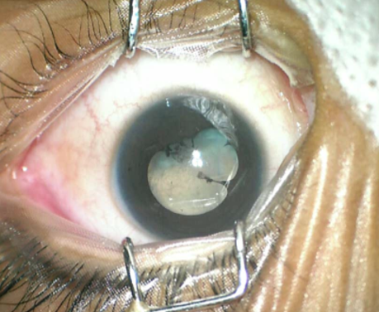
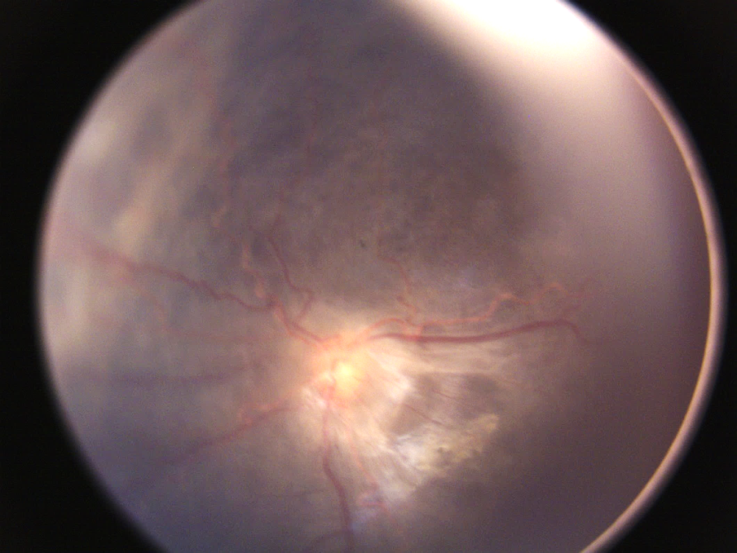
ROP surgery
Stage 5 ROP - Total retinal detachment - Poor prognosis
Surgical trial in hope of restoring navigable vision in bilateral cases
Stage 5 ROP
Postoperative

Slide 10
Key messages
Laser treatment for ROP is effective and has good outcomes
Anti VEGF drugs is useful in adjunct to laser in selected cases
Surgery for ROP is useful in selected advanced cases, but prognosis is poor in stage 5 ROP
Timely ROP screening and treatment is a key to prevent ROP blindness

