Slide 1
Legal issues and follow up
DR. J. KUMUTHA
MD, DCH
Professor & Head
Department of Neonatology
Saveetha Medical College
Thandalam, Chennai

Slide 2
Learning objectives
To know about the
legal issues that can arise
prevention of legal problems
importance of follow up

Slide 3
Legal implications
Legal issues could arise due to
poor communication
poor documentation
complications of the procedure
lack of follow up

Slide 4
Proper communication
The need and timing of ROP screening must be communicated to the parent by:
Doctor
Nurse
Ophthalmologist
Parents language
Check their understanding
Phone call reminders/ linking with local doctor /health worker are also important steps

Slide 5
Consent form
A consent form should include
    the details of nature of disease
    possible side-effects
    complications of the treatment
    at least two languages (simple understandable terms)
The same must be communicated verbally to the parents

Slide 6
Proper documentation
The discharge summary must contain
The findings of the first screening, the date and place for follow-up/ first screening
Advice regarding ROP screening preferably in the local language
The case record must contain the details of the screening and treatment

Slide 7
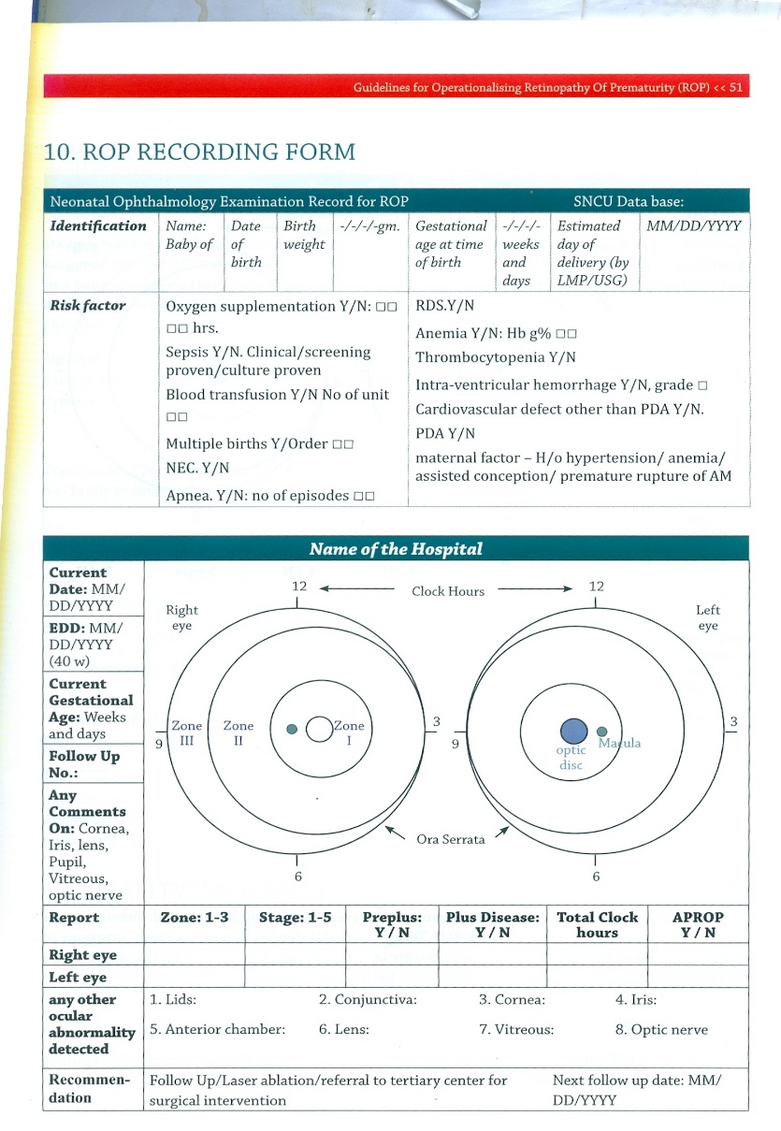
Proper documentation

Slide 8
Checklists
Legal problems can be reduced by a considerable extent only through a system of multiple levels of checks
Assigning roles and responsibility to each personnel (screening line list, screening, treatment and follow up)

Slide 9
Importance of follow-up
Follow up examination should be individualized
It depends on the severity, treatment received and regression of findings
It is absolutely necessary that the neonate undergoes serial examinations till the retina is fully mature
Assessment for visual acuity and squint is continued into childhood

Slide 10
Support system
SNCU/ RBSK team- Paediatrician/ Follow -up nurse/ Optometrist/ DEO
Trained Ophthalmologist
Community level –ANM/ ASHA/ AWW
Screening facility should made available at all SNCUs
Treatment facility at select SNCUs
Availability of early access to treatment
Social and educational support

Slide 11
Key messages
Screening for ROP has to be done at the right time to prevent progression to severe forms
Multiple levels of checks and parents education will ensure follow-up thus avoiding complications and legal issues
Linking with various health functionaries is very crucial for the success of the ROP programme

