Slide 1
Clinical course of Retinopathy of Prematurity
DR. J. KUMUTHA
MD, DCH
Professor & Head
Department of Neonatology
Saveetha Medical College
Thandalam, Chennai

Slide 2
Learning objectives
In this webinar we will learn about the
magnitude
risk factors for ROP
clinical course of ROP

Slide 3
Incidence of ROP
ROP is one of the leading causes of severe visual impairment in childhood
Category | Percentage
ELBW | 16 to 48
VLBW | 27 to 35
LBW (> 1500 gm) | 32
Notes:
ROP is one of the leading causes of severe visual impairment in childhood.
About 27 to 35% of VLBW infants and
16 to 48% of ELBW infants are afflicted with some degree of ROP.
Indian studies have shown that even larger babies have significant ROP
Screening examination of premature infants for
retinopathy of prematurity. Pediatrics. 2013; 131: 189-95

Slide 4
Risk factors
Prematurity and Low birth weight (LBW) are the most important risk factors for the development of ROP
Injudicious use of oxygen - also an important risk factor
Repeated blood transfusions and sepsis are other risk factors
Any sick LBW infant has higher chance of developing ROP

Slide 5
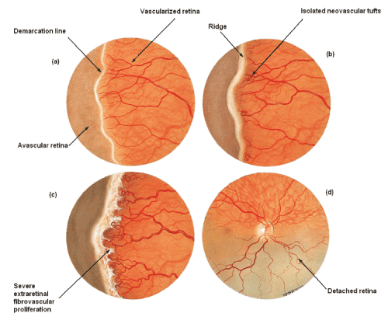
Clinical course of ROP
ROP is a condition characterized by the development of new abnormal blood vessels in the eyes of preterm babies
ROP begins at 31- 32 weeks of postmenstrual age (PMA) and progresses over the next 2 to 5 weeks
However ROP usually does not manifest before 2-3 weeks of postnatal age

Slide 6
Course of ROP
ROP
Spontaneous regression
Progression to retinal detachment
Timely screening will detect ROP requiring treatment and avoid progression

Slide 7
Key messages
ROP is a leading cause of childhood blindness
ROP is a disease of the preterm and sick LBW neonates
Untreated ROP can lead to retinal detachment and blindness

