Slide 1
CPAP Maintenance and monitoring

Slide 2
Maintenance and Monitoring
Flow
  Bubble minimal bubbling (2 to 7 liters/min)
  Ventilator 6 to 8 cms of water
FiO₂ (21% to 60 %) : SpO₂ 90% - 95s%
CPAP (4 to 7 cms) : Recessions / CXR and SpO2

Slide 3
CPAP and FiO2: Proportionality
CPAP | 5 cms | FiO₂ | 50%
CPAP | 6 cms | FiO₂ | 60%
CPAP | 7 cms | FiO₂ | 70 to 100%
CPAP | 4 cms | FiO₂ | 25 to 40%

Slide 4
CPAP
CPAP of < 4 cm H₂O never given!
CPAP of 4-7 cm H₂O is a good range
  Advantages many, disadvantages few!
CPAP of > 7 cm H₂O is a bad range
  Advantages some, disadvantages galore!

Slide 5
Warming and Humidification
Temperature of inspiratory gases at 37º C
Relative humidity of 100%
No condensation in the inspiratory circuit
Some condensation in the expiratory limb

Slide 6
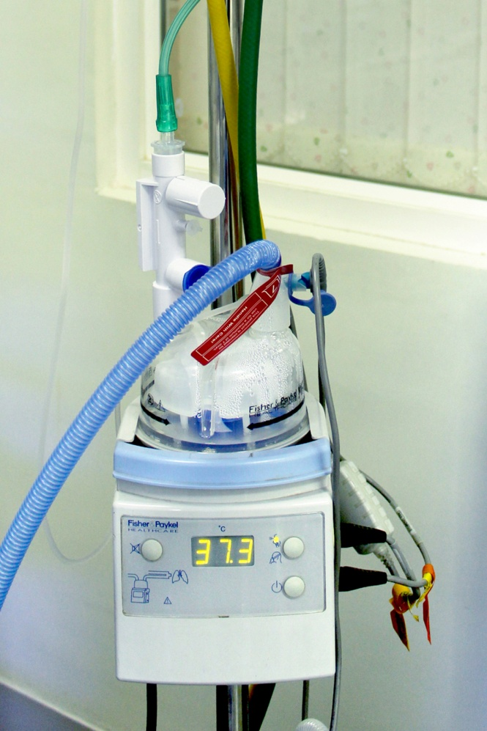
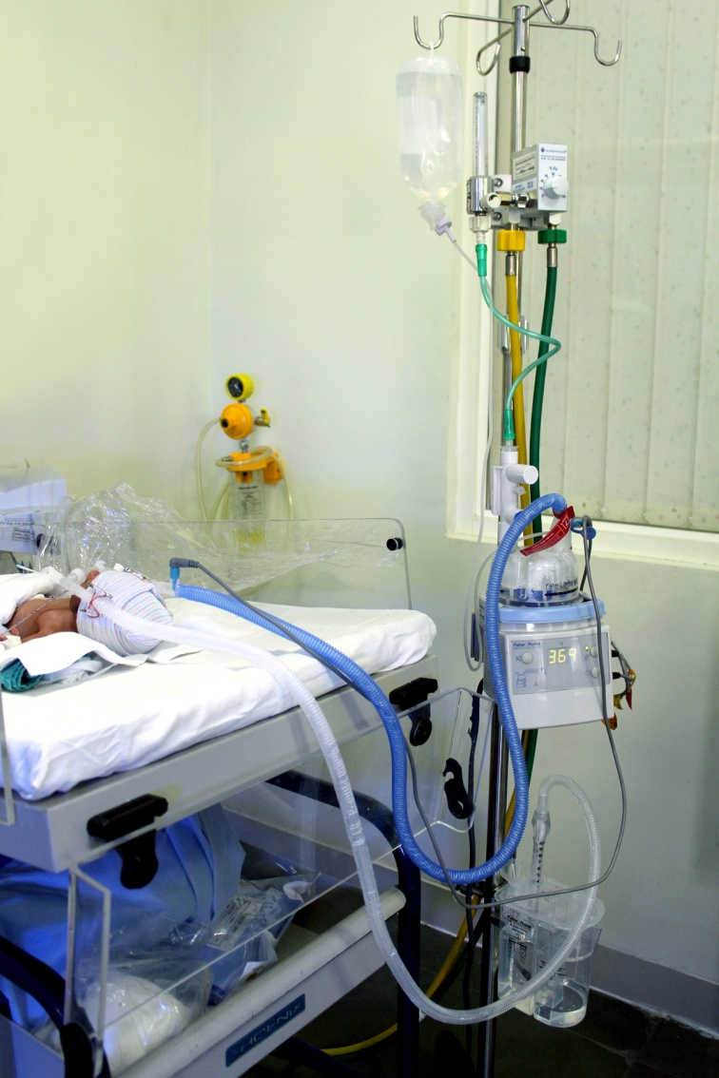
Humidifier
37º c
37º c
39º c
37º c

Slide 7
Monitoring
Patient
  HR, RR, SAS Score, SpO2, Air entry and bubbling
  CFT, Blood pressure, AF, Urine output, Abd girth
Machine
  CPAP pressure, FiO2 and Flow
  Water in humidifier, Bubble chamber
  Condensation in circuit
Interface
  Nasal injury, Cap size, Prong size, Secretions

Slide 8
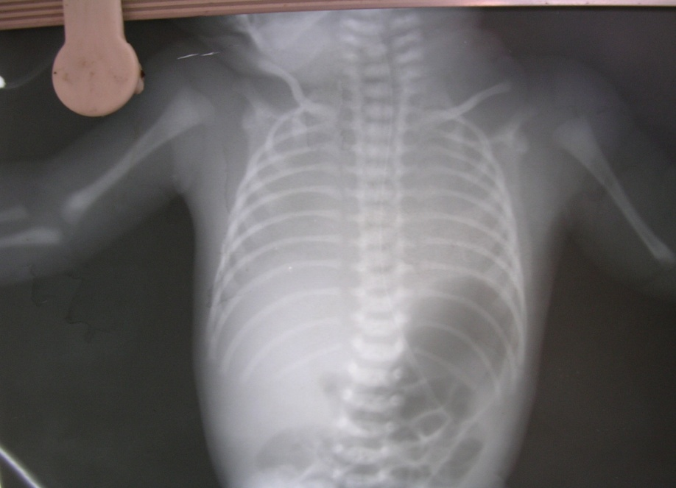
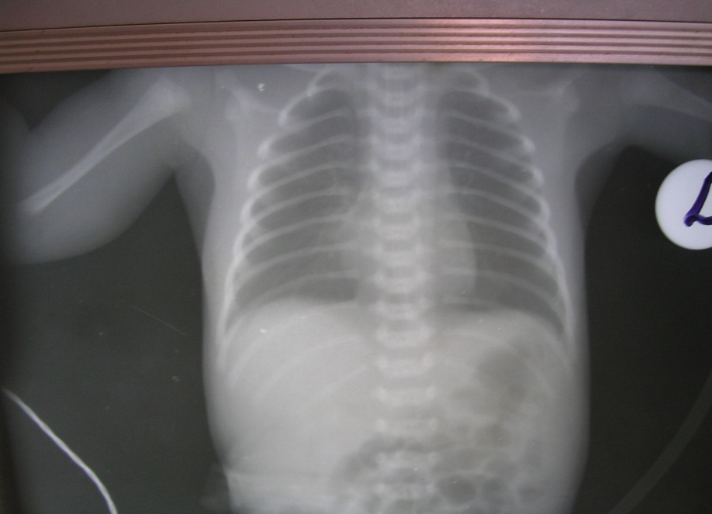

CXR

Slide 9
Adequacy of CPAP
Satisfactory cardiorespiratory status
Comfortable baby
Minimal retraction, no grunt
Normal capillary refill, BP
Normal saturations: 90% - 94%
Normal ABG
(PaO₂ 60-80, PaCO₂ 40-60, pH 7.35-7.45, BE±2)
Bubbling Breath sounds

Slide 10
Weaning
Decrease FiO2 and then CPAP
Every 1 cm decrease in CPAP, aim 10% in FiO2
CPAP : 5cm & FiO2 50%, maintain CPAP till FiO2 is 30%
Decrease CPAP to 4 cm
The disease process has improved
If CPAP 4 cm & FiO₂ < 30% & clinically well (no RD, SpO₂ > 90% & Normal ABG) : Remove CPAP

Slide 11
Procedure after the CPAP
Oral and Nasal suction / Saline nebulization if secretions
Watch for apneas, tachypnea, retractions and bradycardia
Frequent change in positions

Slide 12
Failure of CPAP
Continuing retractions, grunt
Recurrent apneas
SpO₂ <90 %/ PaO₂ < 50 : PEEP > 7 & FiO₂ >60%
PaCO₂ > 55, Poor respiratory efforts
Baby not tolerating CPAP

Slide 13
Reasons for Failure
Failure of the CPAP system
Worsening of baby
  Respiratory
  Cardiovascular
  Neurological

Slide 14
Summary
Titration
  Flow Bubbling
  FiO2 SpO2
  CPAP Recessions/CXR
Proportionality of FiO2 and CPAP
Systematic evaluation: Failure of CPAP

