Slide 1
Barrier nursing
Dr Shiv Sajan Saini
MD, DM (Neonatology)
Assistant Professor
Department of Pediatrics,
PGIMER, Chandigarh

Slide 2
Introduction
Routinely infected neonates
  Universal precautions
Under certain situations - more stringent measures needed
  Highly contagious infections
  Multidrug resistant organisms
  Immuno-compromised patients
Barrier nursing is a set of interventions consisting of stringent infection control practices so as to prevent spread of infections in such situations

Slide 3
Learning objectives
The concepts of barrier nursing
Contact prevention
Personal protective equipment
Respiratory prevention

Slide 4
Barrier nursing concept
Set of interventions
  Stringent infection control practices
  Prevents spread to other neonates/ healthcare workers
Spread of infections through
  contaminated surfaces or hands, fomites, droplets, inhaling aerosols, etc.
Aim is to prevent spread
  from one baby to another
  to medical staff
  outside of unit and hospital

Slide 5
Universal precautions
Standard precautions exercised during routine nursing care
Assume everyone infected
Includes
  Hand hygiene
  Use of gloves, gowns, masks during handling patients' body fluids
  Prevention of fomites
  Disinfecton of anything which comes in contact with the baby

Slide 6
Cohorting
For multidrug infections
  Universal precautions - strengthened
  Neonate(s) cohorted away from rest of the neonates
  Separate health care professionals
  Appropriate PPE
  Separate biomedical waste disposal

Slide 7
Body substance isolation
Body fluids handling
  After donning appropriate PPE
  Discard in yellow bin
If secretions or excreta are highly contagious
  Special way to donn PPE
  Special way to discard PPE
  Each neonate requires separate PPE
  Appropriate separate biomedical disposal

Slide 8
Donning Personal Protective Equipment
Firstly, gown
Mask or respirator
Goggles or face shield
Gloves

Slide 9
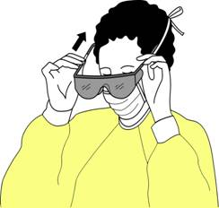
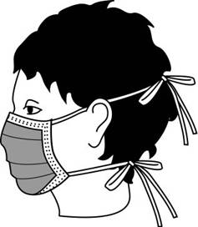
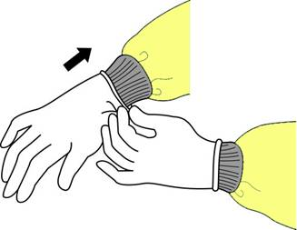
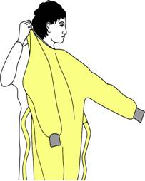
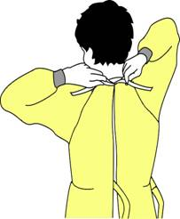
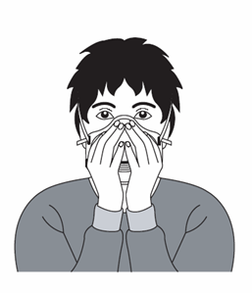
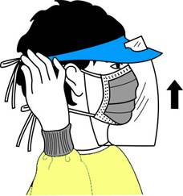
Personal protective equipment - Donning

Slide 10
Removing PPE
Gloves
Face shield or goggles
Gown
Mask or respirator

Slide 11
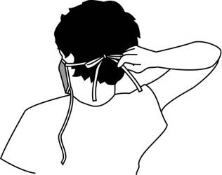
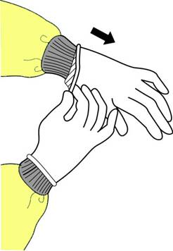
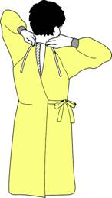
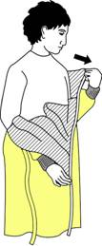

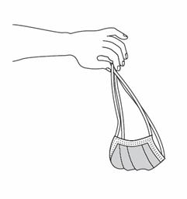
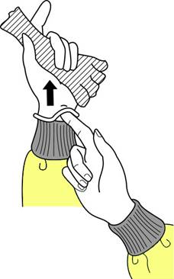
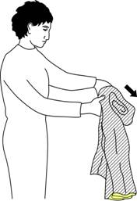
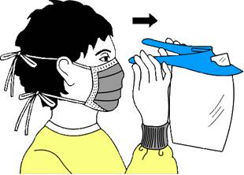
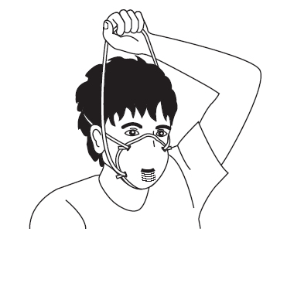
Removing PPE- steps

Slide 12
Airborne precautions
In cases of airborne transmission of infectious agents
  Airborne droplet residue (5 µm or smaller)
Special air handling and negative pressure ventilation of the room
Generally not available

Slide 13
Summary
Barrier nursing is an effective way of preventing infection spread within SNCU
Universal precautions should be exercised during usual SNCU care
In case of neonates with highly contagious infections, appropriate PPE should be worn in addition. The particular sequence of donning and removal of PPE must be adhered to
Respiratory isolation is required for infections with the risk of airborne transmission

